Slide 1
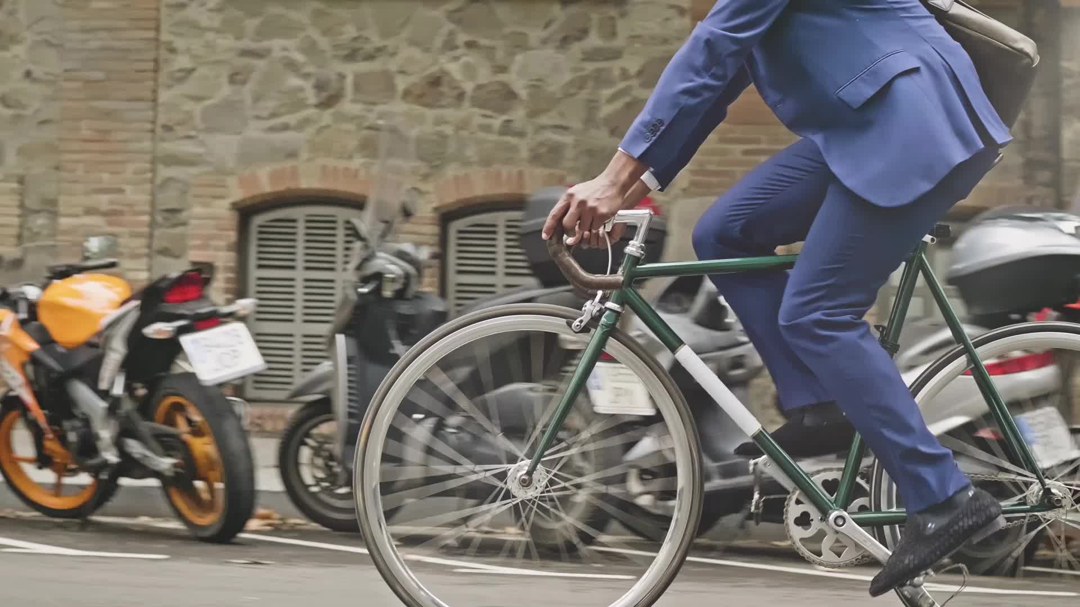
Cyclistic Bike-Share Case Study March 2022 – February 2023
Deepanshu Bisht
18/02/23

Slide 2
Table of Contents
About and purpose of case study
Showing data
Conclusion and Recommendations

Slide 3

About
Chicago’s Cyclistic is a business that rents out bicycles.
600 docking stations and more than 5,800 bicycles are part of this bike-sharing program.
By providing reclining bikes, hand tricycles, and cargo bikes in addition to normal two-wheeled bikes, Cyclistic stands apart from the competition and makes bike sharing more accessible to users with impairments.

Slide 4

Data Summary
March 2022 – February 2023
4.4 million total number of rides.

Slide 5

Purpose of the Study
In order to boost the number of annual member riders, your team needs to learn how casual riders and annual members utilize bicycles differently.
The marketing team will develop strategies to turn casual riders into annual members using the insights.

Slide 6
Total Rides by members
Annual members ride 20% more than casual drivers

Slide 7
Total Rides past 12 months
Here you can see, there are fewer rides in the winter season. (December to February)
Peak rides are from May to September.

Slide 8
Ride Count in a week
We can see that annual members travel more on weekdays than casual riders.
Casual riders ride bike more on weekends

Slide 9
Type of bike used by casual & annual member
Here we can see that Classic Bike is mostly preferred by annual members and more favored by casual riders.
E-bikes are the second most preferred by Annual and Casual riders.
Docking bike type is least & only preferred by casual members

Slide 10
Average ride duration of members
Casual riders have an average ride length of 23:37 minutes.
For an annual member it is 12:23 minutes

Slide 11
Average ride length by month
Casual riders traveled for longer duration in May, for avg 27:35 minutes.
Annual members took a long trip in June for avg 13:41 minutes.
Smaller trips takes place in December i.e., of avg 14 minutes 44 seconds, done by casual riders.
At 9 minutes 58 seconds, the shortest avg ride time is taken by annual members in January.

Slide 12
Average ride length by Week
Both casual and annual members on an average spend longer time on trips on weekends.

Slide 13
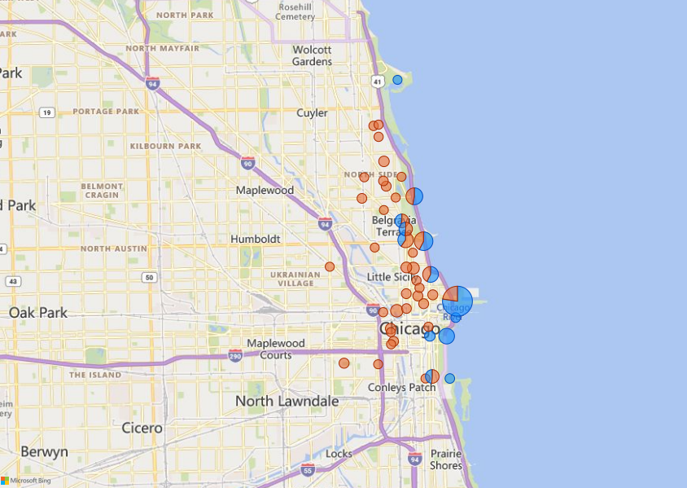
Total Rides
This map shows riders favorite docking stations with more than 8000 trips
Here, the largest concentration of casual members in blue is Southern California, which is rich in greenery and seascapes, meaning that casual riders have traveled most for leisure purposes.
On the other hand, the annual members in orange are mostly in northern and western California, i.e., urban areas, suggesting they commute to the office by bike.

Slide 14

Conclusion
Casual riders spent twice as much time traveling compared to Annual members.
There are more summer weekend trips by Casual riders than Annual members.
The largest concentration of Casual riders is in green and oceanic Southern California. Annual membership, on the other hand, is concentrated primarily in Northern and Western California, where offices and residences are located.
It can be concluded that Casual riders traveled most frequently for leisure purposes and annual members used bicycles to commute.

Slide 15

Recommendations
To convert casual riders into annual members, especially in Southern California, more advertising needs to be scheduled during weekends and summer.
Cyclistic Bike can introduce new memberships for weekend riders.
Cyclistic Bikes can devise a marketing strategy to attract casual drivers on weekdays, like discount on Annual membership fee for Casual riders during weekday trips.

Slide 16

Thank You

